Slide 1

WELCOME
TO

Slide 2
DATA LITERACY WITH TABLEAU
PROJECT TITLE:
UNVEILING MARKET INSIGHTS: ANALYSING SPENDING BEHAVIOUR AND IDENTIFYING OPPORTUNITIES FOR GROWTH.

Slide 3
TEAM PROFILE ;
NM TEAM ID NM2023TMID15924
TEAM LEADER :
NACHIMUTHU.S : NM_ID: ED8824F299856D2942C4D41BE6A2279A
TEAM MEMBERS:
KATHIRAVAN.S : NM_ID: CE7D3468E27005FB99E4A0433D6DE674
LOKESH KUMAR.V : NM_ID: 2875FDA8A308DA399DD46AAAE2A59037
MUKESH.K : NM_ID: 23BD4100045E03482424C10EDF4A2846

Slide 4

UNDER THE GUIDANCE OF
Mr.S.SATHISH,M.Sc.,M.Phil.,
GUEST LECTURER
PG & RESEARCH Department of Mathematics,
Government Thirumagal Mills College,
Gudiyatham – 632602.

Slide 5

INTRODUCTION
OVER VIEW
Wholesaling or distributing is the sale of goods to retailer to industrial, commercial, institutional or other professional businessman to other wholesalers (wholesale businesses) and related subordinated services. Wholesaling is buying goods in bulk quantity, usually directly from the manufacturer or source, at a discounted rate. The retailer then sells the goods to the end consumer at a higher price making a profit.
The consumption and production of marketed food are spatially separated. Production is primarily in rural areas while consumption is mainly in urban areas. In today's highly competitive business landscape, gaining deep market insights is essential for businesses to thrive and grow. This project aims to analyze customer spending behavior and identify opportunities for growth by leveraging data analytics and data-driven decision-making.
The primary objective of this project is to understand customer spending patterns, preferences, and trends across various dimensions.. By conducting a comprehensive analysis, businesses can optimize their marketing strategies, improve product offerings, and enhance customer engagement to drive revenue growth.

Slide 6
2. PURPOSE
ANALYTICAL THINKING: A market insights expert must be able to break down data out relevant information.
EXCELLENT COMMUNICATION SKILL: You must be able to clearly and persuasively present your findings while working with company decision- making and data. You must be an effective communicator, verbally and in writing.
Spot trends and opportunities in your industry.
Demonstrating product value, strengthening brand loyal and ultimately increasing sales.

Slide 7
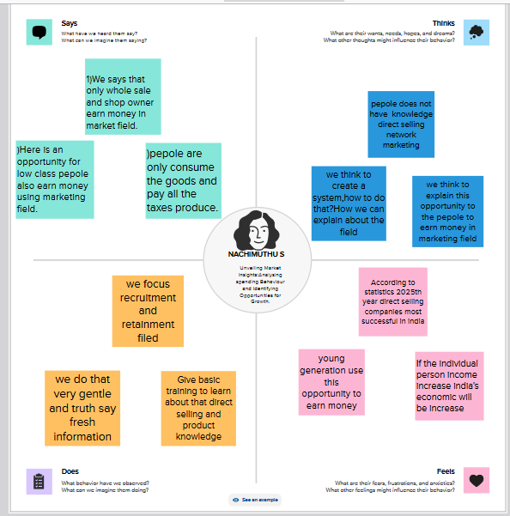
PROBLEM DEFINING & DESIGN THINKING

Slide 8
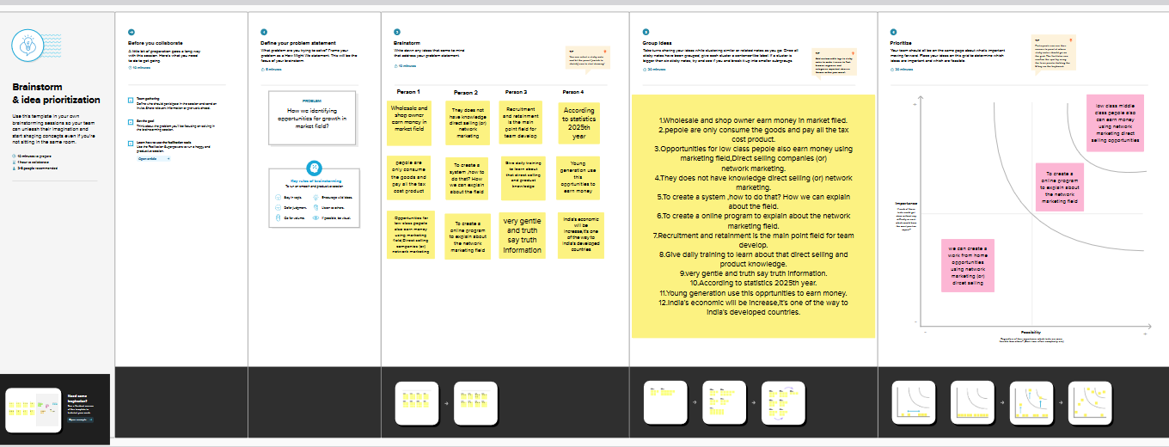
BRAIN STORMING MAP

Slide 9
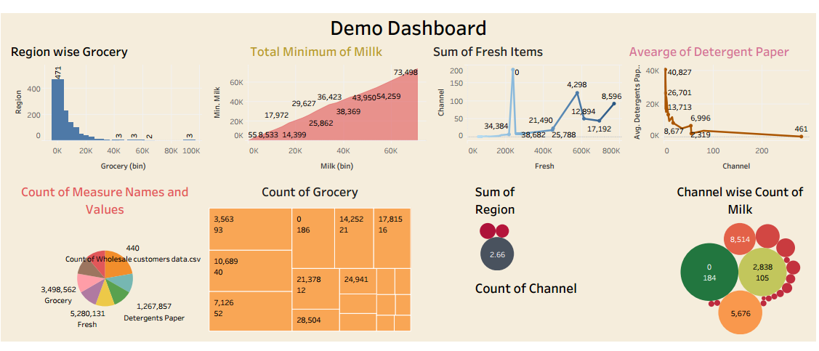
RESULT
DASH BOARD

Slide 10
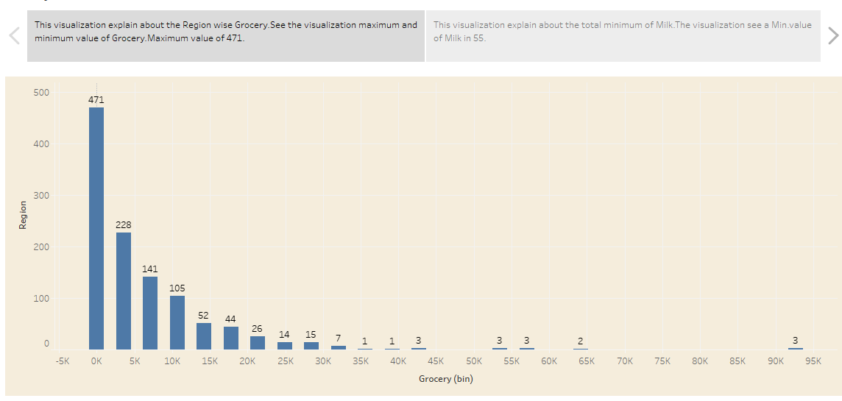
STORY
Visualization 1:

Slide 11
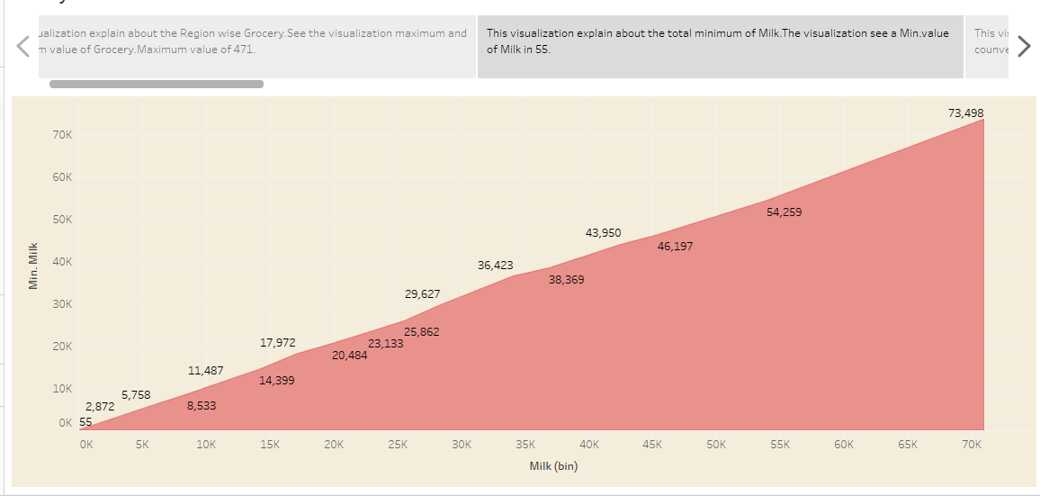
Visualization 2:

Slide 12
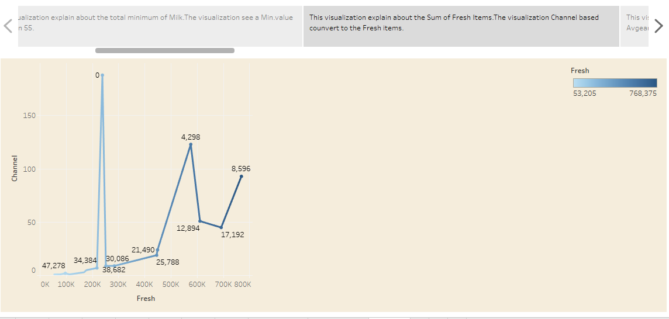
Visualization 3:

Slide 13
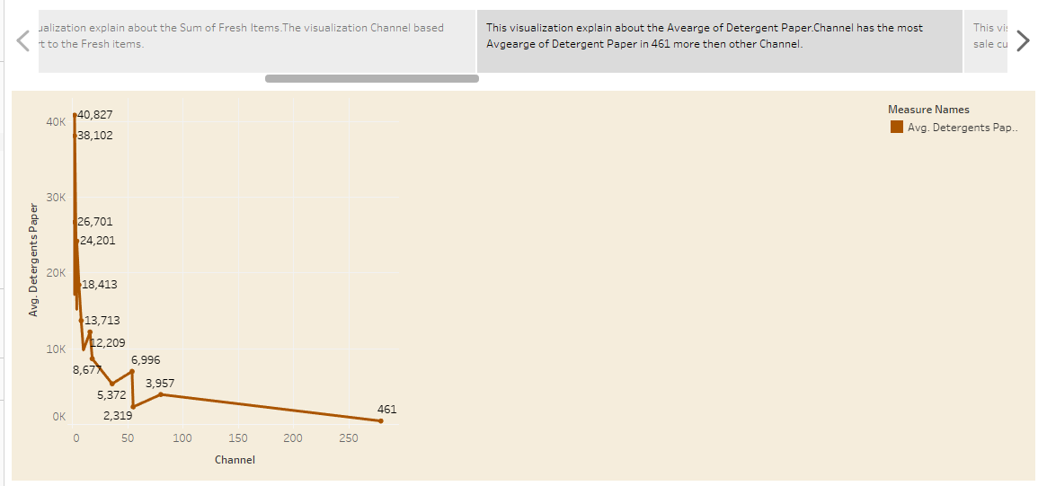
Visualization 4:

Slide 14
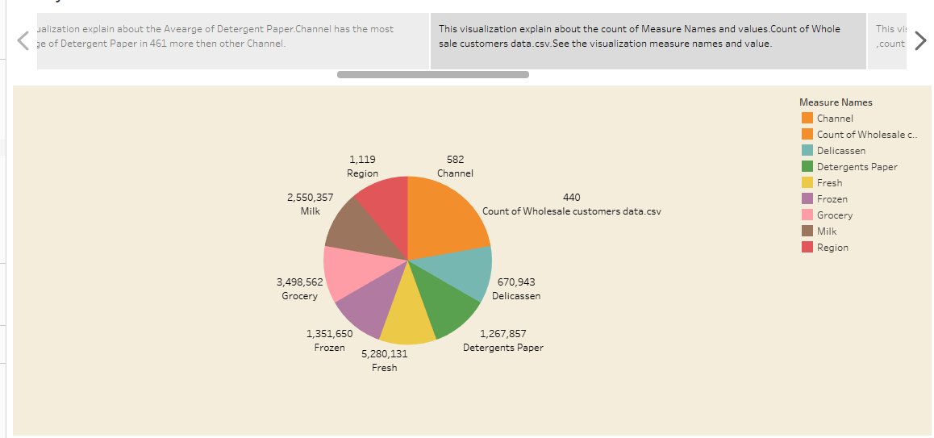
Visualization 5:

Slide 15
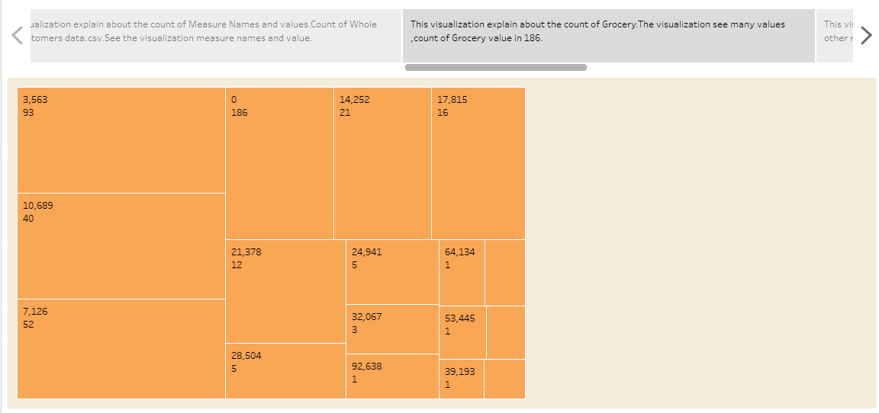
Visualization 6:

Slide 16
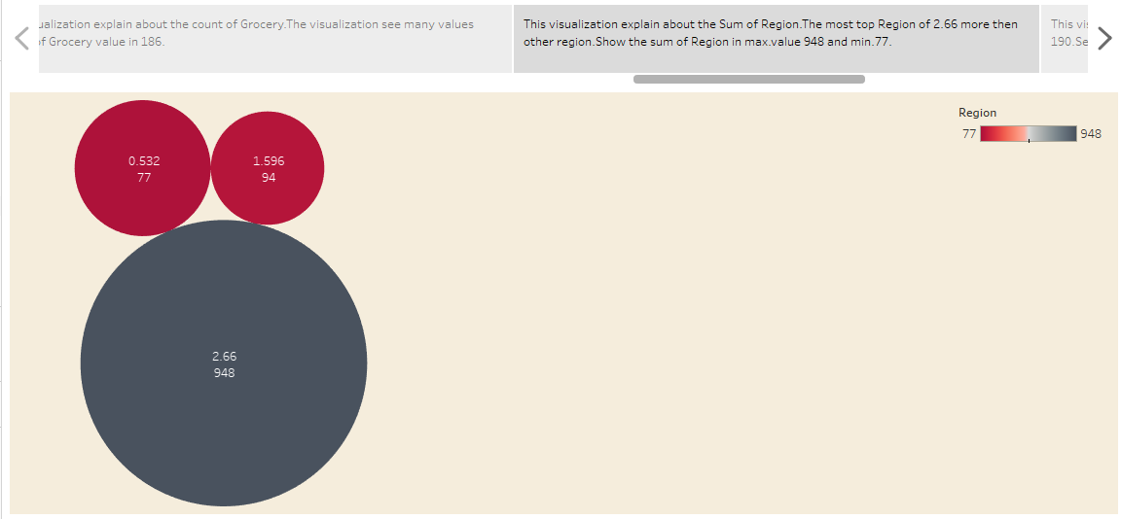
Visualization 7:

Slide 17
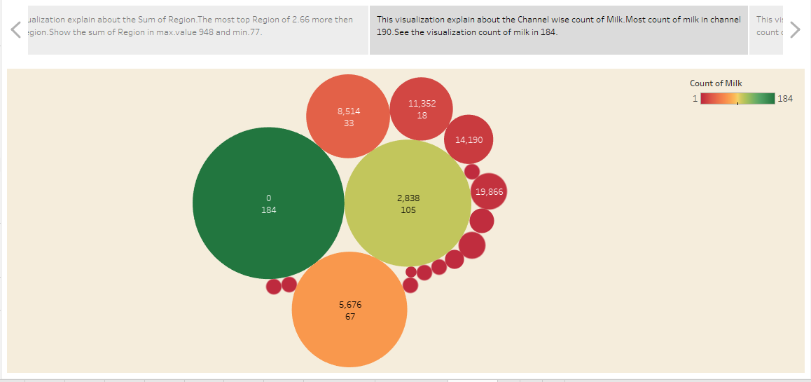
Visualization 8:

Slide 18
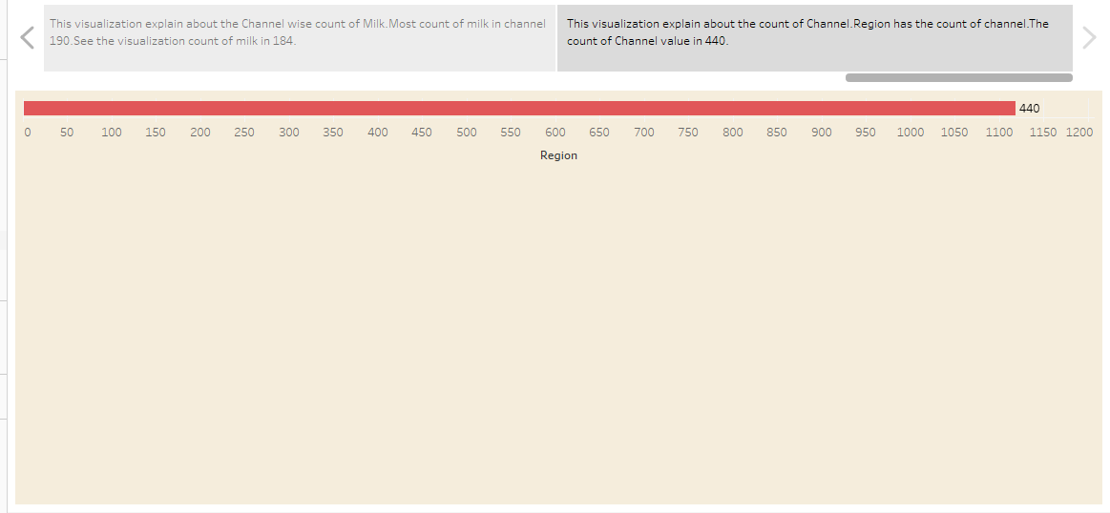
Visualization 9:

Slide 19
DESHBOARD LINK:
https://public.tableau.com/app/profile/nachimuthu.s/viz/NMDemo_16962968668090/Dashboard2
STORY LINK:
https://public.tableau.com/app/profile/nachimuthu.s/viz/UnveilingMarketInsightsAnalysingspendingBehaviourAndIdentifyingOpportunitiesForGrowth/Story1

Slide 20
CONCLUSION:
Generally, see a overall, We See a .
Intro of this the Data literacy with tableau:
Unveiling Market Insights : Analysing Spending Behaviour And Identifying Opportunities For Growth.
2.Problem Definition & Design Thinking.
3.Result.
4.Dashboard link.
5.Story link.

Slide 21
THANK YOU

